Slide 1
How to do an Academic Research Poster
Gregg W. Etter Sr. Ed.D.
Professor of Criminal Justice
University of Central Missouri

Slide 2
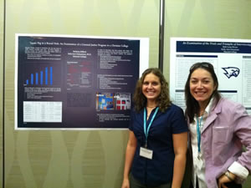
What is an Academic Poster?
An academic poster is a representation of research using visual and text sections to convey the content to the viewer.
Poster presentations are common at the American Society of Criminology and Academy of Criminal Justice Sciences annual conferences.
However, these presentations. usually only involve faculty, graduate and post-graduate students

Slide 3
Determination of Research D.O.R.
The CJ graduate assistant will help you fill out the DOR form properly.
The Institutional Research Board at UCM requires that all students participating in any kind of research including posters complete a Determination of Research form.

Slide 4
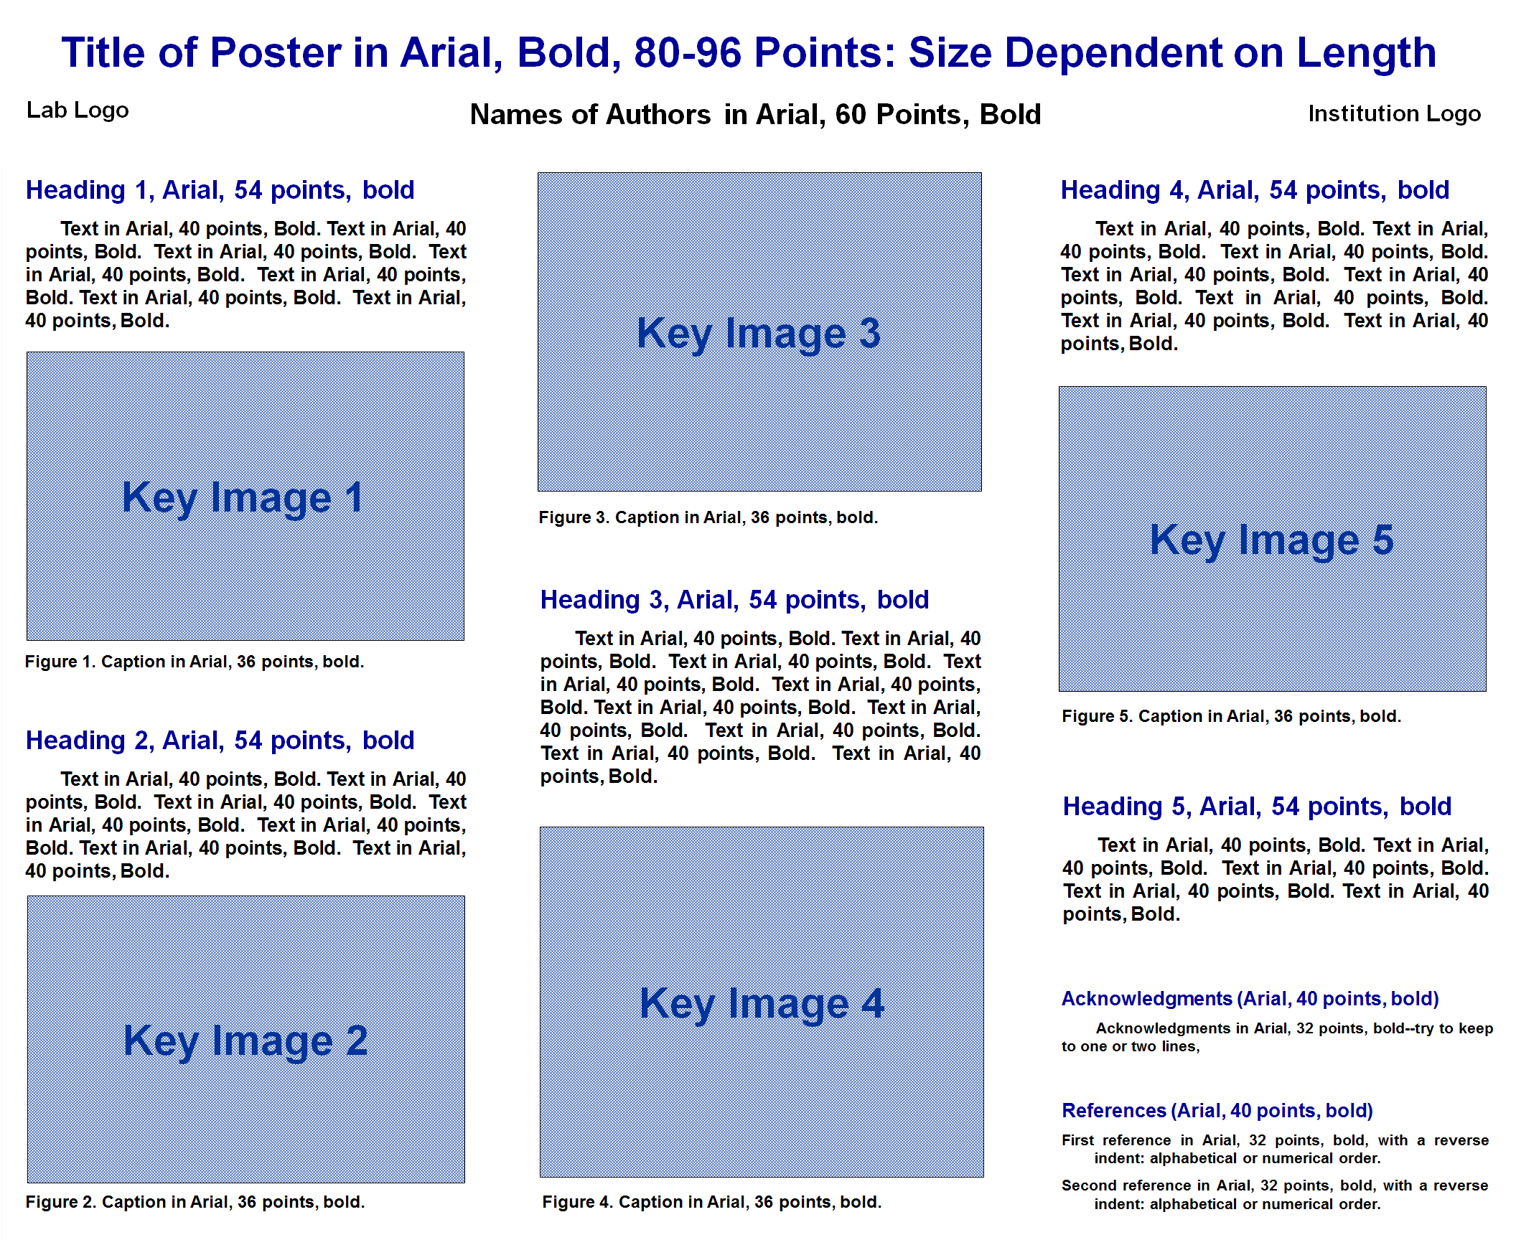
Poster Template #1

Slide 5
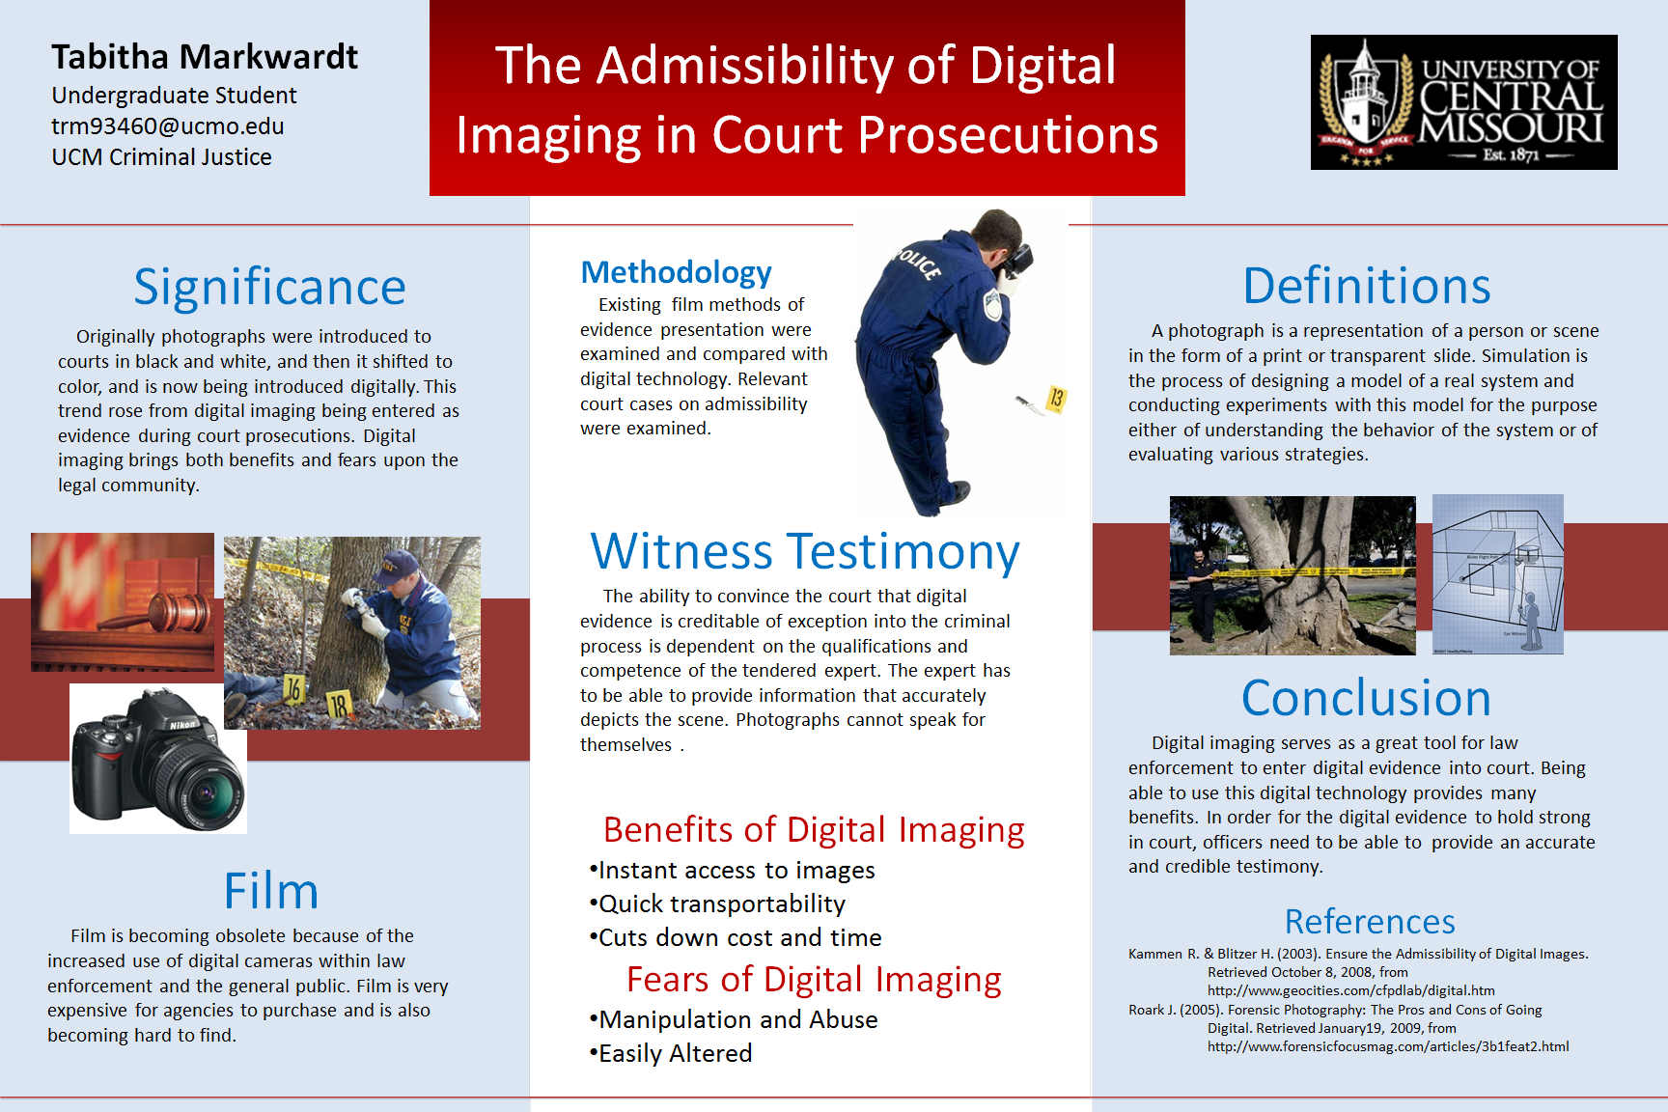
Sample Student Poster#1

Slide 6
Sample Student Poster#2

Slide 7
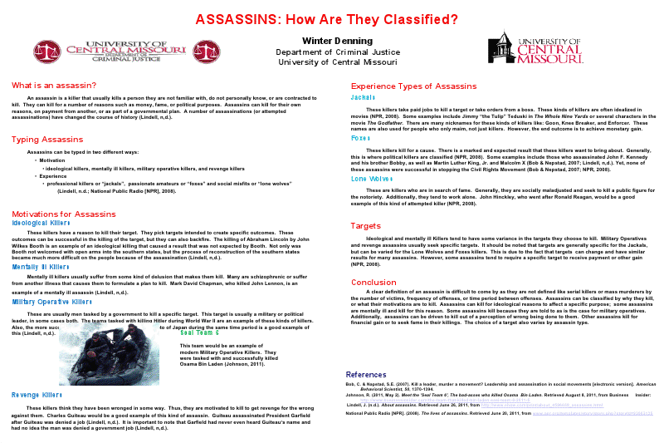
Sample Student Poster#3

Slide 8
Student Poster#4

Slide 9
Sample Poster#5

Slide 10
Sample Poster#6

Slide 11
Sample Poster#7

Slide 12
Sample Poster#8

Slide 13
Sample Poster#9

Slide 14
Sample Poster#10

Slide 15
What Information Must Be On My Poster
There are many templates that can be download from the internet at no cost. Your poster should contain:
1. Your Name
2. Your Chapter/School
3. Your Level of Competition (Lower, Upper, Graduate)
4. Content
5. References

Slide 16
Academic Poster Competitions are divided into three divisions.
Lower Division: Freshman and Sophomores
Upper Division: Juniors and Seniors
Graduate Division: All Graduate Students.

Slide 17
How Would the Posters be Graded?
Under this proposal , the LAE posters would be graded using a rubric developed by Dr. Lynn Urban of the University of Central Missouri.
Students will receive their grade after they have presented their posters in an approved venue.

Slide 18
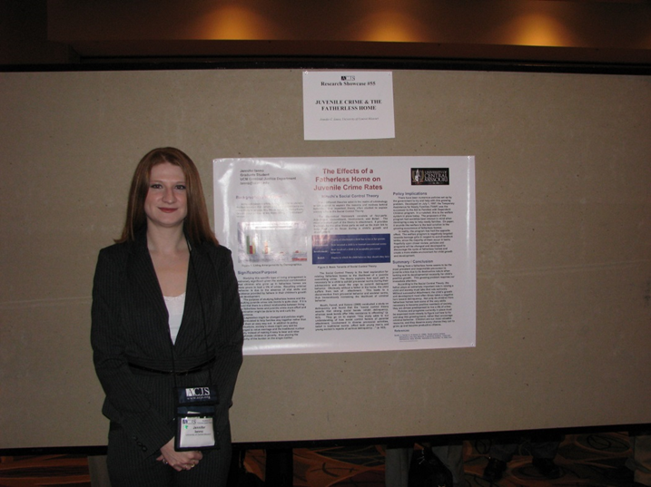
How Would the Posters be Presented?
Traditionally, posters are presented in a paper format at an approved academic venue. Under this proposal, rather than presenting actual paper posters, posters would be entered into a Power Point presentation.
The student physically stands by their poster and answers questions about their research.
Traditional approved academic venues for UCM students include: MCA, ASC, ACJA/LAE and ACJS.
Occasionally, the CJ Department sponsors an on campus academic conference that allows poster presentations.

Slide 19
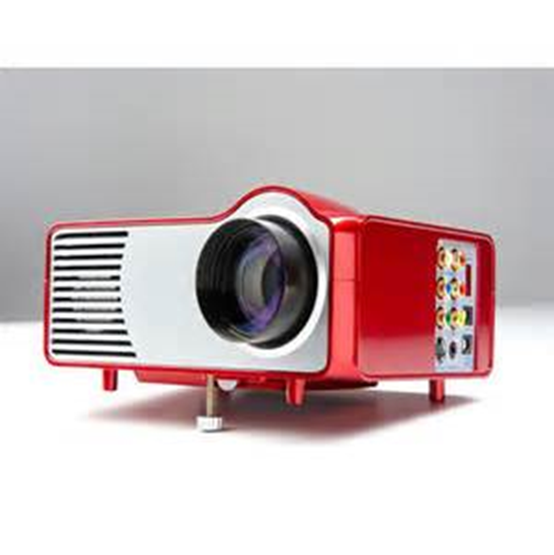
Virtual Poster Presentations
In a virtual poster presentation, rather than presenting actual paper posters, posters would be entered into a Power Point presentation.
The presentation would be set on a 90 second loop as developed by Dr. Gene Bonham of the University of Central Missouri.
The posters would then be presented throughout the day on any suitable available showing surface thus avoiding having to tape or pin anything to walls.
Traditional approved academic venues for UCM students include: ACJA/LAE and MTSU Virtual Poster Competition.

Slide 20
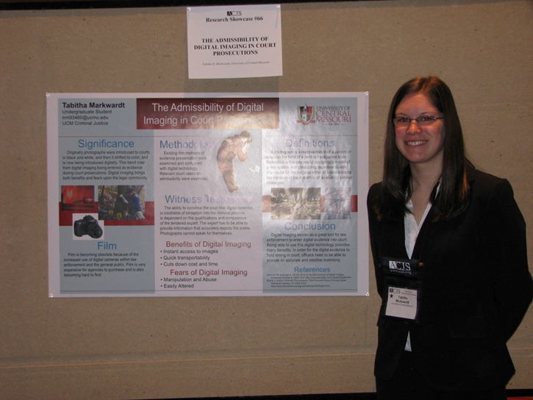
The Purposes of an Academic Poster
To foster academic research by UCM criminal justice students.
To allow UCM criminal justice students a forum to present their academic research.
To prepare UCM criminal undergraduate students for graduate study and employment in law enforcement and corrections.

Slide 21
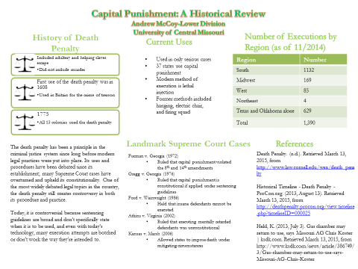
Summary
The academic research poster provides another avenue for UCM CJ students to show their academic excellence.
It provides a tangible student work product to enhance a student’s curriculum vitae.
Presentation demonstrates academic potential to possible graduate school administrators or employers.
The UCM CJ Department has a Poster Machine for paper posters.
Virtual posters are presented on powerpoint

